Slide 1
take it or
leaf it?
LT 13 | Basak, Chua, Danao, Roberto

Slide 2


Slide 3

crop loss due
to disease &
damage

Slide 4

more stats
about cordillera

Slide 5
background on plant diseases

Slide 6



low-cost
accurate
instant

Slide 7


Slide 8
oh my
gul AI

Slide 9
crop disease
identifier

Slide 10
crop disease
identifier
powered by artificial intelligence

Slide 11
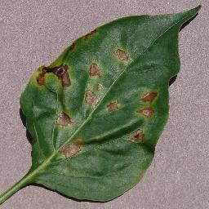
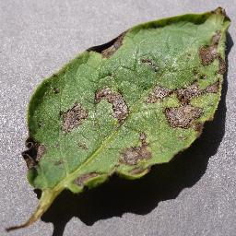
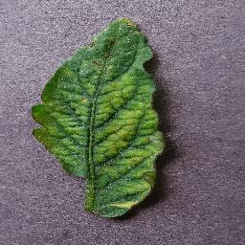
how does it work?
( labeled photos )

Slide 12
how does it work?
Bacterial
Spot
Blight
Mosaic
Virus
( labeled photos )

Slide 13

how does it work?
Bacterial
Spot
.
.
.
.
.
.
.
.
.
.
.
.
.
.
.
.
.
.
.
.
.
.
.
.
.
.
.
.
.
.
.
.
.
.
.
.
.
.
.
.
.
.
.
.
.
.
Blight
.
.
.
.
.
.
.
.
.
.
.
.
.
.
.
.
output
.
.
.
.
.
.
.
.
.
.
.
.
.
.
.
.
.
.
.
.
.
.
.
.
.
.
.
.
.
.
.
.
.
.
.
.
.
Mosaic
Virus
( labeled photos )

Slide 14
97.7%
* across five trials
prediction made in
less than 1 second

Slide 15




Slide 16
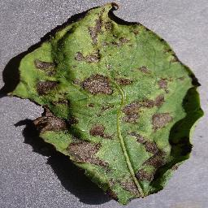
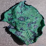

256 x 256
64 x 64

Slide 17
97.7%
* across five trials
prediction made in
less than 1 second

Slide 18
97.2%
* across five trials
prediction made in
less than 1 second

Slide 19
earlier detection to
determine right treatment
loss prevention to
maximize farmer capital
eliminate threat to
food security
Notes:
classify without needing expertise
avoid infection and negative effect in production

Slide 20
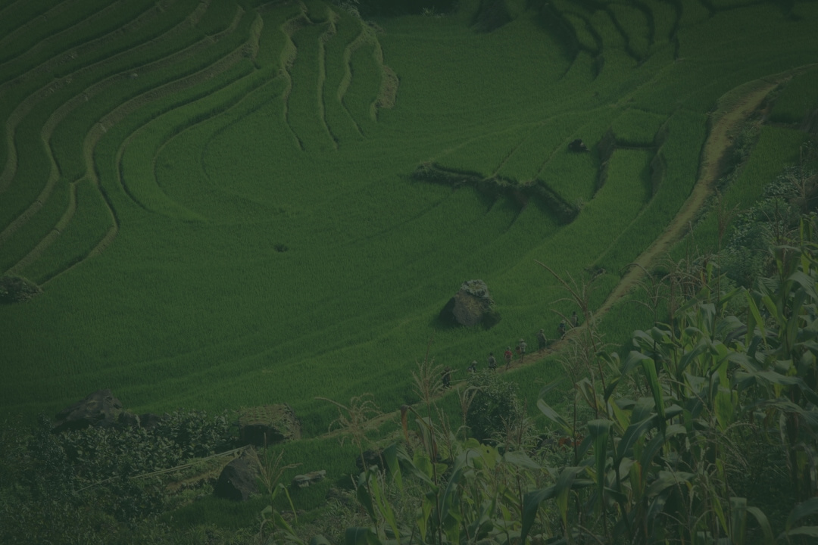
oh my
gul AI

